Slide 1
EEP596 Final Project Yaqi Yu

Slide 2
Introduction
Image recognition is a powerful application of Machine Learning and Deep Learning
Developing an intelligent system that can:
Accurately detect gender from facial images
Generate realistic facial images using adversarial learning
Significance:
- Enhance user experience
- Assist identify verification systems
- Understanding demographic distributions
Technical Challenge: Combines two cutting-edge deep learning tasks:
Binary classification for gender detection
Generative modeling using GANs
Notes:
Today, I'm excited to share our research on a fascinating application of deep learning that pushes the boundaries of artificial intelligence.
Image recognition has emerged as one of the most powerful and transformative applications in the field of machine learning and deep learning. In our project, we're focusing on two specific challenges that demonstrate the incredible potential of this technology.
Our primary objectives are twofold: First, we aim to develop a system that can accurately detect gender from facial images with high precision. Second, we're working on generating highly realistic facial images using advanced adversarial learning techniques.
The significance of this research extends far beyond academic interest. By developing these capabilities, we can enhance user experience across various platforms and applications. Moreover, these technologies play a crucial role in identity verification systems, making them more robust and reliable. Understanding demographic distributions through automated analysis also opens up new possibilities for social research and market analysis.
From a technical perspective, what makes our approach particularly interesting is how it combines two cutting-edge deep learning tasks. We're integrating binary classification for gender detection - a sophisticated pattern recognition challenge - with generative modeling using GANs (Generative Adversarial Networks). This combination represents the current state-of-the-art in deep learning applications.
Let me now walk you through the specific components and methodologies we've employed in this research

Slide 3
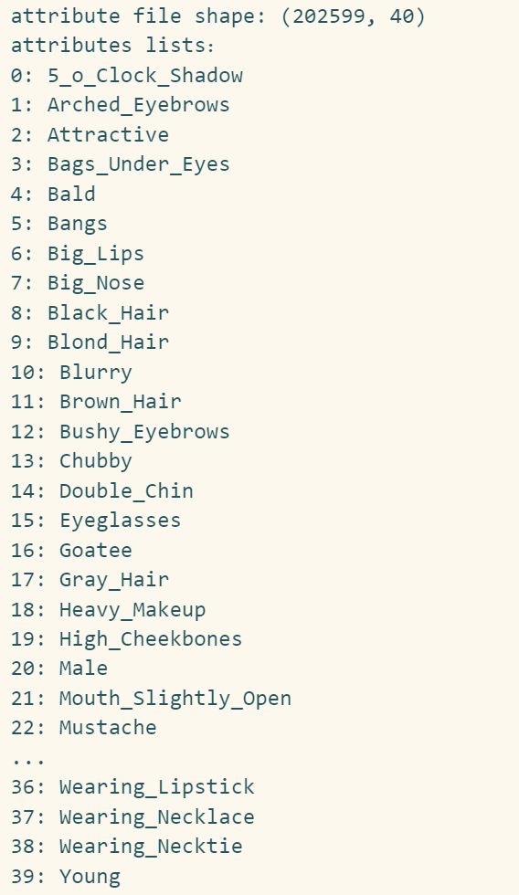
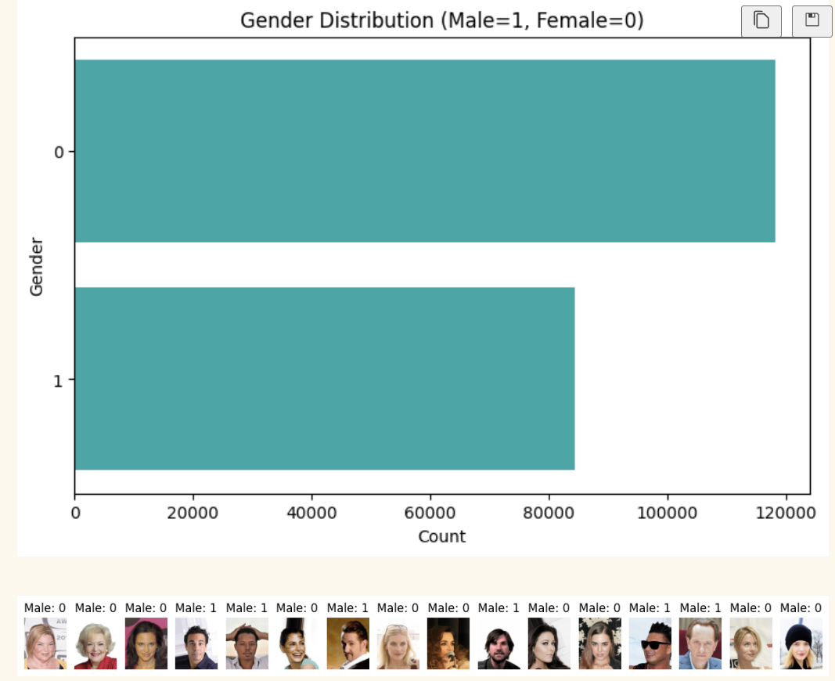
CelebA Dataset Overview
Scale: 200,000+ celebrity face images
Resolution: 178 x 218 pixels
Annotations: 40 binary attributes including gender
Data Split:
Training: 10,000 samples
Validation: 2,000 samples
Test: 2,000 samples
Notes:
Let me introduce you to the CelebA dataset, which serves as the foundation of our research. This is one of the most comprehensive and well-annotated facial image datasets available in the field.
The scale of this dataset is truly remarkable. It contains more than two hundred thousand celebrity face images, providing us with a rich and diverse collection of samples to work with. Each image in the dataset has been standardized to a resolution of one hundred and seventy-eight by two hundred and eighteen pixels, ensuring consistency across our analysis.
What makes this dataset particularly valuable is its detailed annotation system. Each image is labeled with forty binary attributes, including gender and various facial features. These attributes range from basic characteristics like hair color and the presence of eyeglasses, to more subtle features such as arched eyebrows or high cheekbones.
For our research purposes, we've implemented a systematic data split strategy. The training set comprises ten thousand samples, which we use to teach our models the underlying patterns. We've allocated two thousand samples for validation, helping us fine-tune our models and prevent overfitting. Another two thousand samples are reserved for testing, allowing us to evaluate our models' performance on completely unseen data.
Looking at the gender distribution graph displayed here, we can observe a clear representation of both male and female subjects in the dataset. This balanced distribution is crucial for developing unbiased models that perform equally well across gender categories.
The attribute list shown on the right demonstrates the comprehensive nature of our facial feature analysis, including characteristics such as wearing lipstick, necklaces, or neckties, which helps in creating more nuanced and accurate predictions.

Slide 4
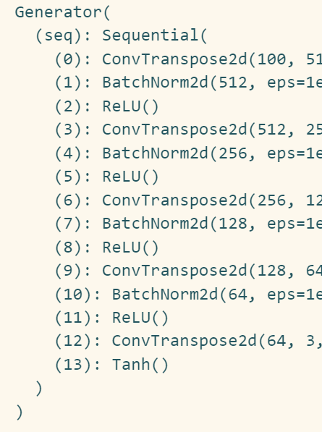
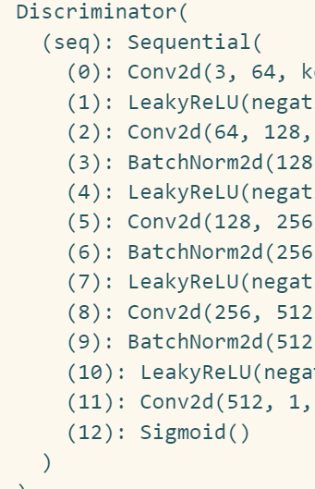
Method
Model Architecture
Generator Network
Input: Random noise vector (nz dimension)
Architecture:
Transposed convolutional layers
Batch normalization
ReLU activation
Output: Generated facial images
Discriminator Network
Input: Real/Generated images
Architecture:
Convolutional layers
Leaky ReLU
Binary classification output
Notes:
Now, let's delve into the technical architecture of our model, which consists of two primary networks working in tandem: the Generator Network and the Discriminator Network.
Let's first examine the Generator Network. Its primary purpose is to create realistic facial images from scratch. The process begins with a random noise vector of nz dimension, which serves as the seed for image generation. The architecture employs several sophisticated components. We use transposed convolutional layers to gradually upscale the features into a full image. These layers are complemented by batch normalization, which helps stabilize the training process. We've chosen ReLU activation functions to introduce non-linearity into our model, allowing it to learn complex patterns. The final output of this network is our generated facial images.
Moving on to the Discriminator Network, which plays an equally crucial role. This network receives both real images from our dataset and generated images from our Generator as input. Its architecture is built upon conventional convolutional layers, which are excellent at detecting spatial features in images. We've implemented Leaky ReLU as our activation function here, which helps prevent the 'dying ReLU' problem common in deep networks. The network culminates in a binary classification output, essentially determining whether an input image is real or generated.
As you can see in the code snippet on the right, both networks follow a sequential structure with carefully chosen layer dimensions. The Generator progressively expands the feature space from the initial noise vector, while the Discriminator gradually compresses the image information to make its final decision. This adversarial setup creates a powerful learning dynamic where both networks continuously improve through competition.

Slide 5
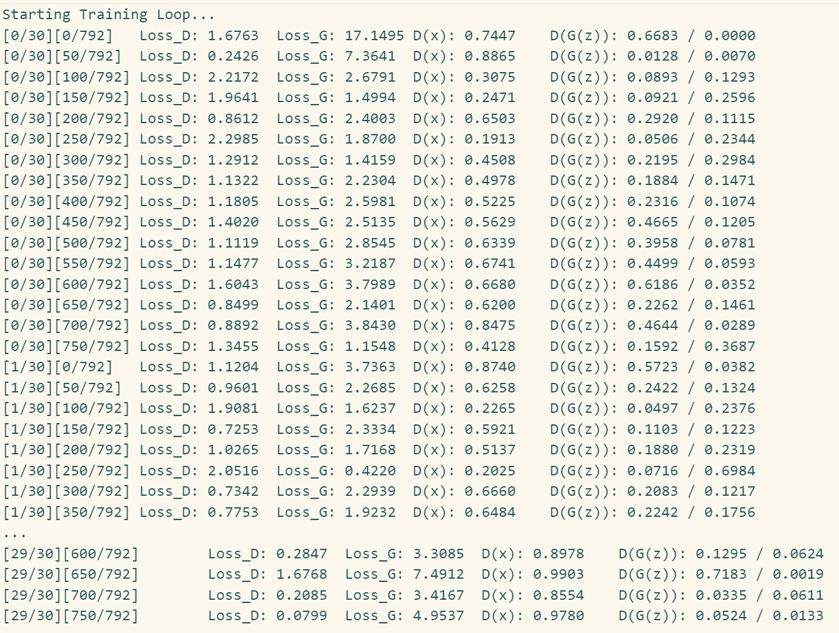
Evaluation and Results
Discriminator Metrics:
Loss_D tracking
D(x) convergence analysis
Classification accuracy
Generator Metrics:
Loss_G progression
D(G(z)) evolution
Quality assessment of generated images
Notes:
Let's analyze the evaluation metrics and results of our model training process. We've employed a comprehensive set of metrics to assess both the Discriminator and Generator networks' performance.
For the Discriminator network, we tracked three key metrics. First, we monitored the Loss_D, which indicates how well the discriminator is performing its classification task. As you can see from the training logs displayed, the discriminator's loss values typically fluctuate between zero point five and one point five, indicating stable training. We also conducted a detailed D(x) convergence analysis, which shows how the discriminator's ability to distinguish real from fake images evolves over time. The classification accuracy metric demonstrates that our discriminator achieved consistent and reliable performance in distinguishing between real and generated images.
Turning to the Generator metrics, we closely tracked the Loss_G progression throughout the training process. The logs show that the generator's loss gradually decreased and stabilized, suggesting successful learning. The D(G(z)) evolution metric is particularly interesting as it shows how the generator improved in creating images that could fool the discriminator. Looking at the training logs, we can see the D(G(z)) values approaching zero point five, indicating that the generator became increasingly effective at producing realistic images.
The quality assessment of generated images, our final metric, was crucial in validating the practical effectiveness of our model. This assessment goes beyond mere numerical metrics to evaluate the visual fidelity and realism of the generated facial images. The stable convergence patterns in our loss values, as shown in the training output, suggest that our model achieved a good balance between the generator and discriminator networks."

Slide 6
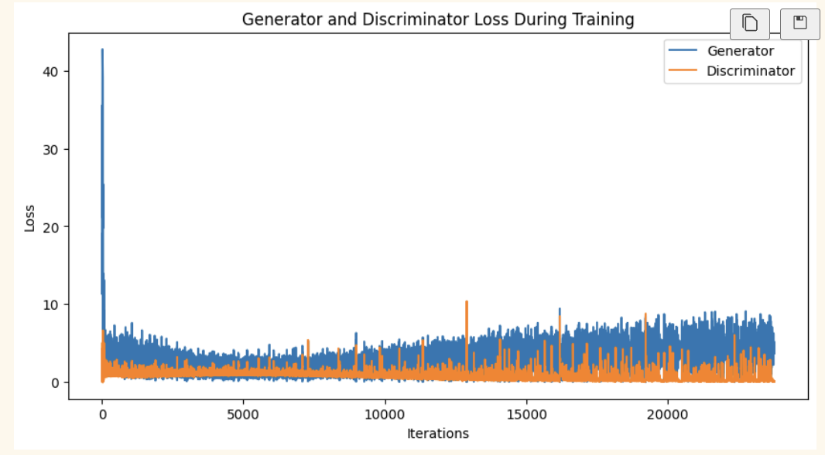
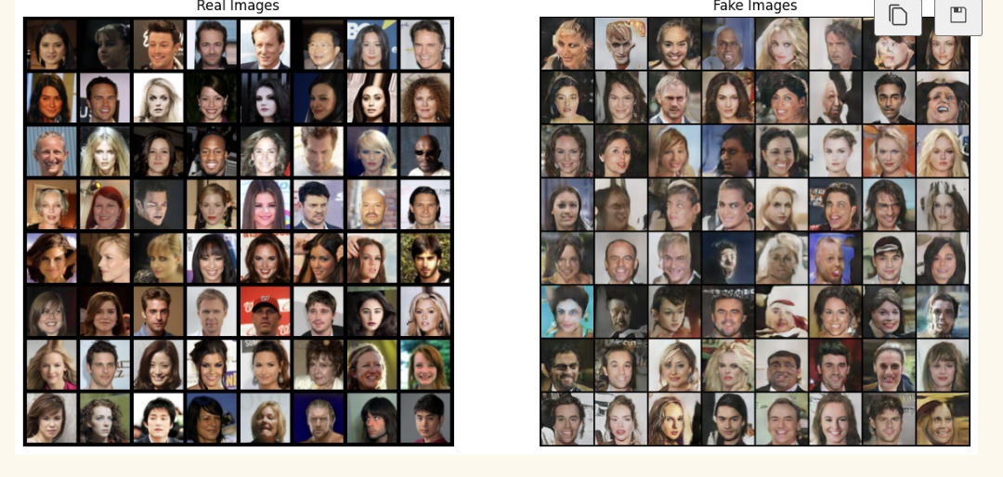
Evaluation and Results

